Slide 1



杭州启点模型科技有限公司
Hangzhou qidian model technology co., LTD
Qidian Promotion Introduction
Update Time: 2025
Department: Marketing Department
更新时间：2020.12.12

Slide 2
CATALOG
01
Company profile
02
Scope of business
03
Product introduction
04
Cooperative partner

Slide 3
Company profile

Slide 4

Hangzhou qidian model technology co., LTD
Hangzhou Qidian Model Technology Co., Ltd. is located on the banks of the Qiantang River in Hangzhou. Since its establishment, relying on the established professional technical team, the company has given full play to its advantages in talents and technologies. For a long time, it has been dedicated to the development, research and production of various model mold prototypes 3D printing, teaching and experimental equipment, instruments and devices. At present, it has more than 30 engineering and technical personnel in mining engineering, electrical engineering, machinery, computer science, architectural engineering, etc.
The various model mold prototypes 3D printing, teaching and experimental equipment and devices produced by the company are closely combined with the characteristics of real needs, fully reflecting the characteristics of various models and devices. The company strictly controls the selection of raw materials, production, quality inspection and other aspects of the products, thus ensuring the reliability and stability of the products.

Slide 5
The scope of the company's products includes: sand table models, mechanical models, aviation and ship models, industrial and civil building models, mining models, electronic and electrical models, roads and bridges, various display boards and teaching boards, mold prototypes 3D printing, etc.
The company adheres to the belief that serving customers is the only reason for Qidian's existence, and customer needs are the driving force for Qidian's development. We adhere to a customer-centric approach, respond quickly to customer needs, and continuously create long-term value for customers to achieve customer success.
Company Creed: Forge Qidian with the Spirit of Craftsmanship
We firmly believe that our professionalism and sense of responsibility will surely provide you with satisfactory services!

Slide 6
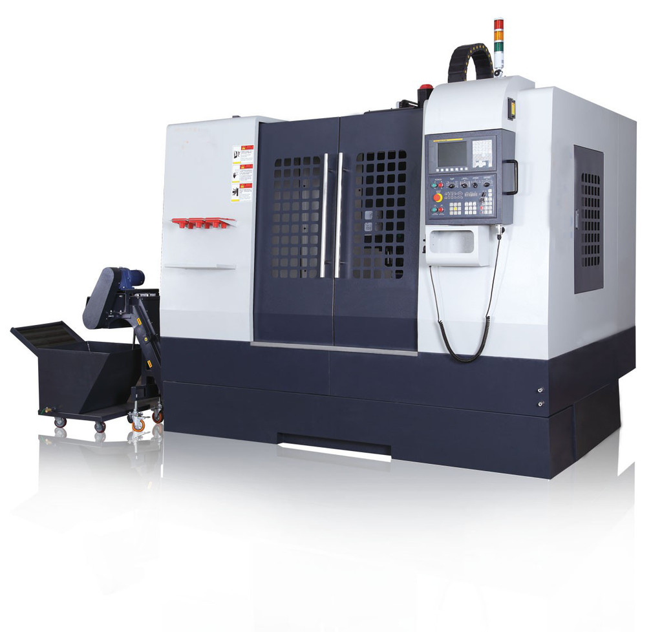
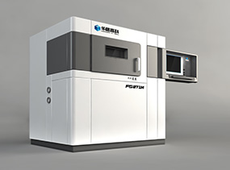

Professional Equipment
CNC Machining Center
3D Printing：
Able to quickly print models with special structures
●High machining accuracy and high processing quality;
●Can perform multi-coordinate linkage and process complex-shaped parts;
●Meet the processing and manufacturing of complex models

Slide 7



启
点
MODEL
Professional Design
For each project, design 2D or 3D renderings according to requirements. More intuitively show customer needs and facilitate effective communication.
Elaborate Polishing
Exquisite models are inseparable from attentive and meticulous polishing. Each model grasps every production process to reflect the required details.
Display
Arrange lights and exhibition stands according to the model structure and display characteristics to make the model more ornamental

Slide 8
Scope of business

Slide 9
Schools
Exhibition
Halls
Scope of business
Others
Enterprises

Slide 10
Sand Table Models
Mechanical Models
Ship Models
Aerospace Models
01
02
03
04
Sales Office Sand Table Model, Terrain Model, Multimedia Sand Table Model, Regional Planning Mode
Factory Assembly Line Model, Laboratory Model Device, Shield Machine Model, Shearer Model, Crane Model, Fully Mechanized Mining Face
Container Ship Model, Bulk Carrier Model, Cruise Ship Model, Liquefied Gas Ship Model, Ancient Sailing Ship Model
Rocket Model, Satellite Model, Rocket Launch Tower Model, Space Station Model, Return Capsule Model

Slide 11

Netherlands
Australia
South Korea
United States
Scope of business
Dubai
Kenya

Slide 12
Product introduction

Slide 13
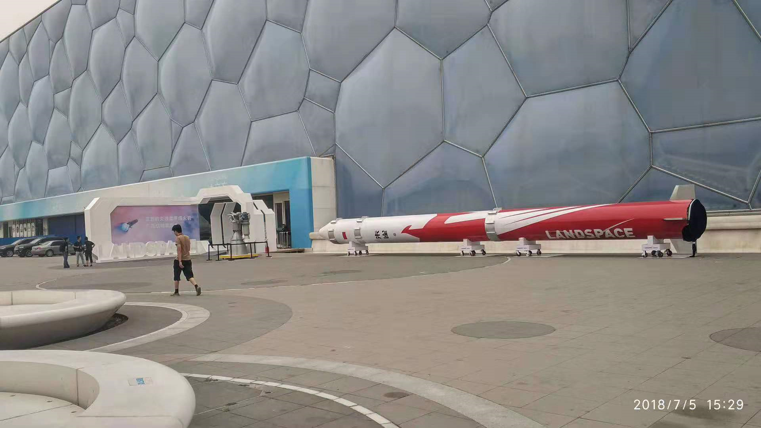

Rocket Model
1:1 Rocket Model, Total Length 19m, Made of Steel, Surface Sprayed with Automobile Paint, Total Weight 3 Tons
Rocket Model
Rocket Engine Model, Made of Metal

Slide 14
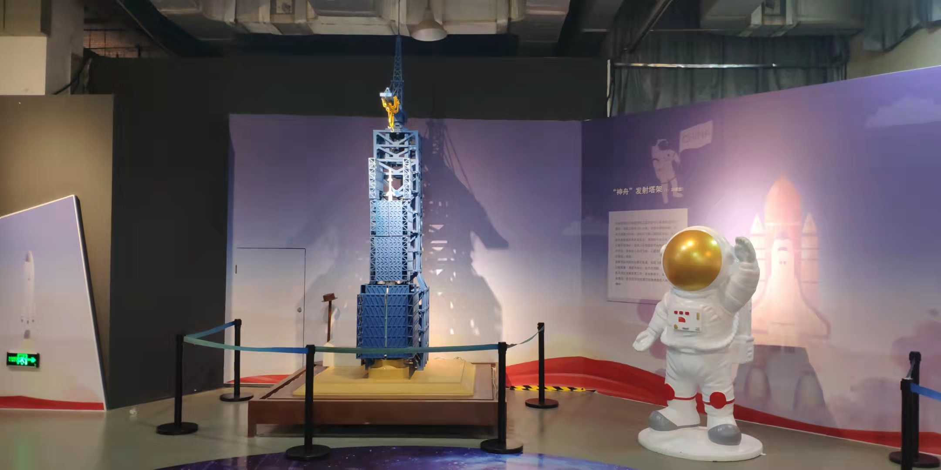
Rocket Launch Tower Model
Height 4.3m, Rocket 1.8m, Made of Metal, Surface Sprayed with Automobile Paint, PLC Programming Control, Simulation Action Demonstration. Total Weight 3 Tons
Rocket Launch Tower Model

Slide 15
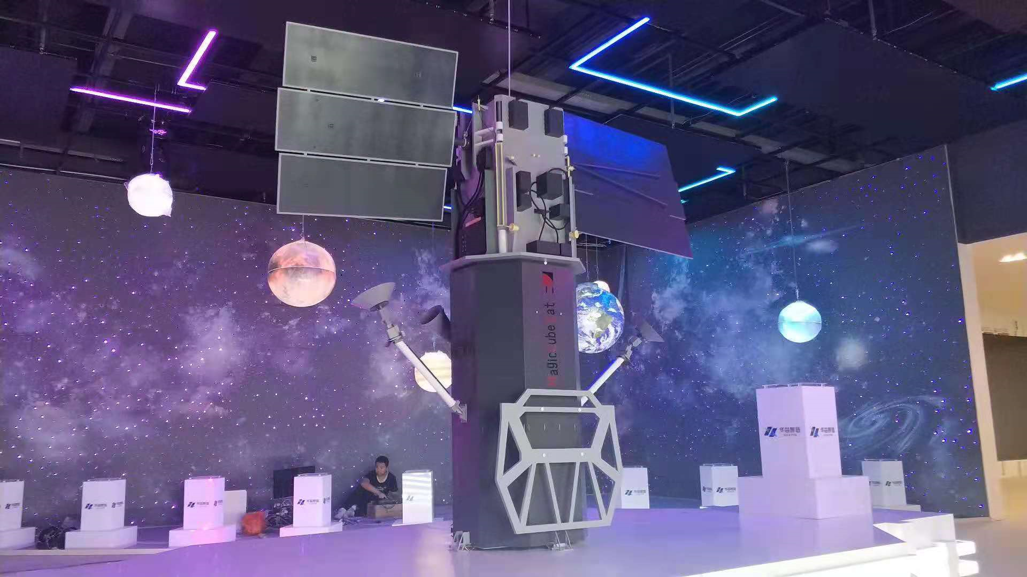

Satellite Model
Height 2.1m, Made of ABS, Surface Sprayed with Automobile Paint. Total Weight 100KG
SatelliteModel

Slide 16
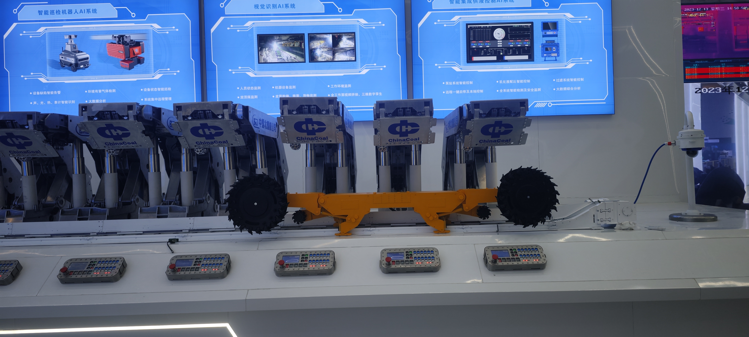
Coal Mining Face Model
Height 2.1m, Made of Aluminum Alloy, ABS, etc., Surface Sprayed with Automobile Paint. Total Weight 2000KG
Coal Mining Face Model

Slide 17
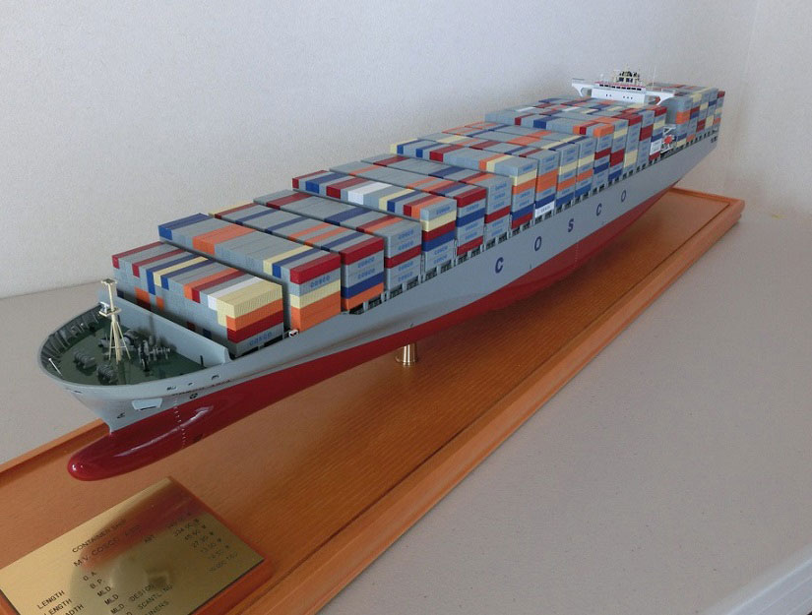
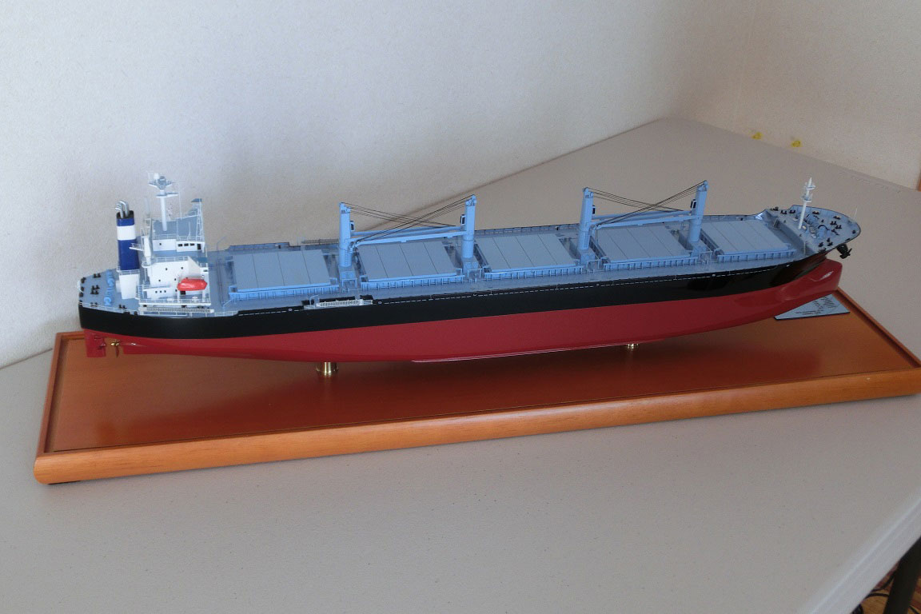
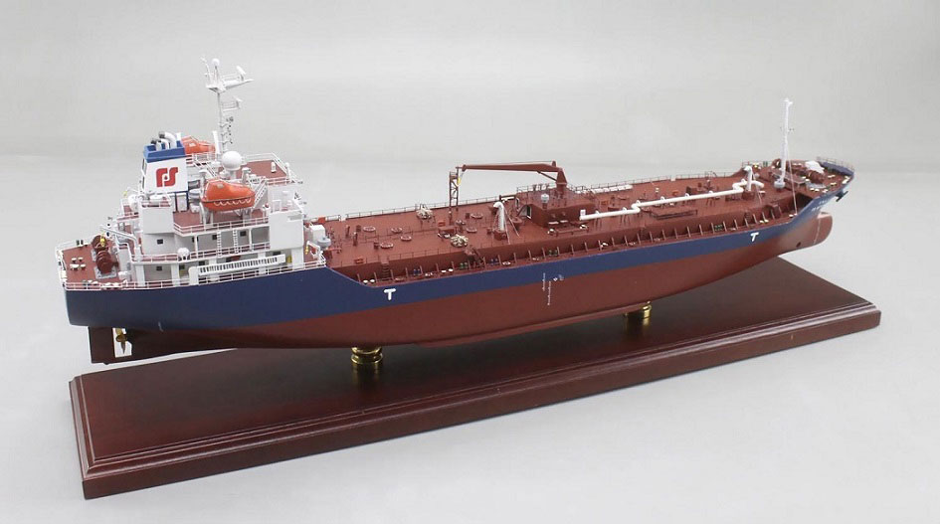
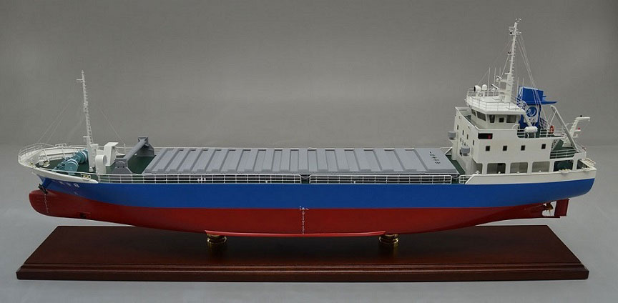
Ship Models

Slide 18
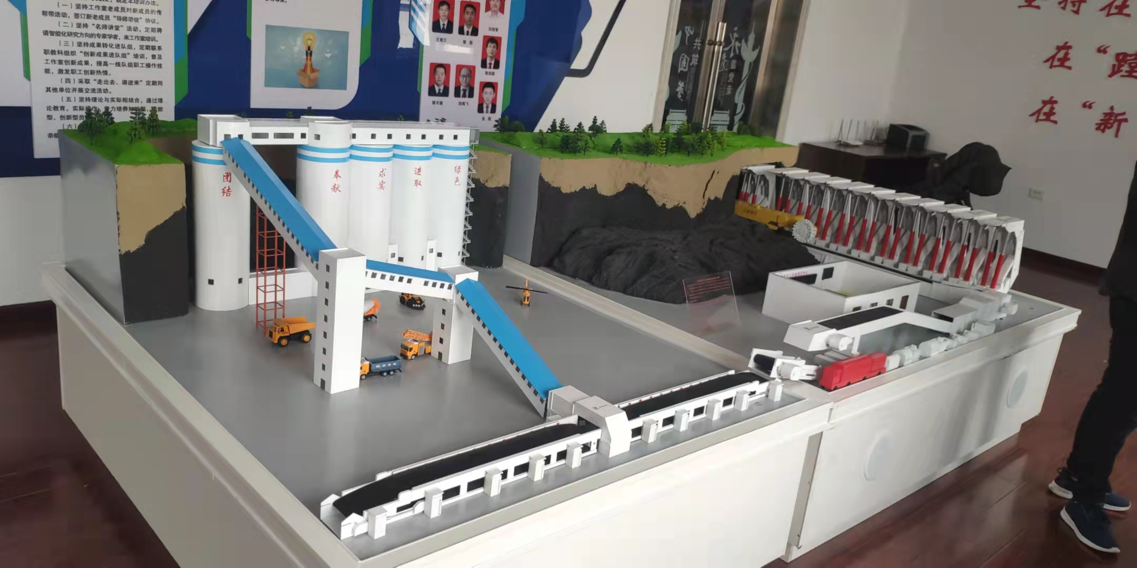
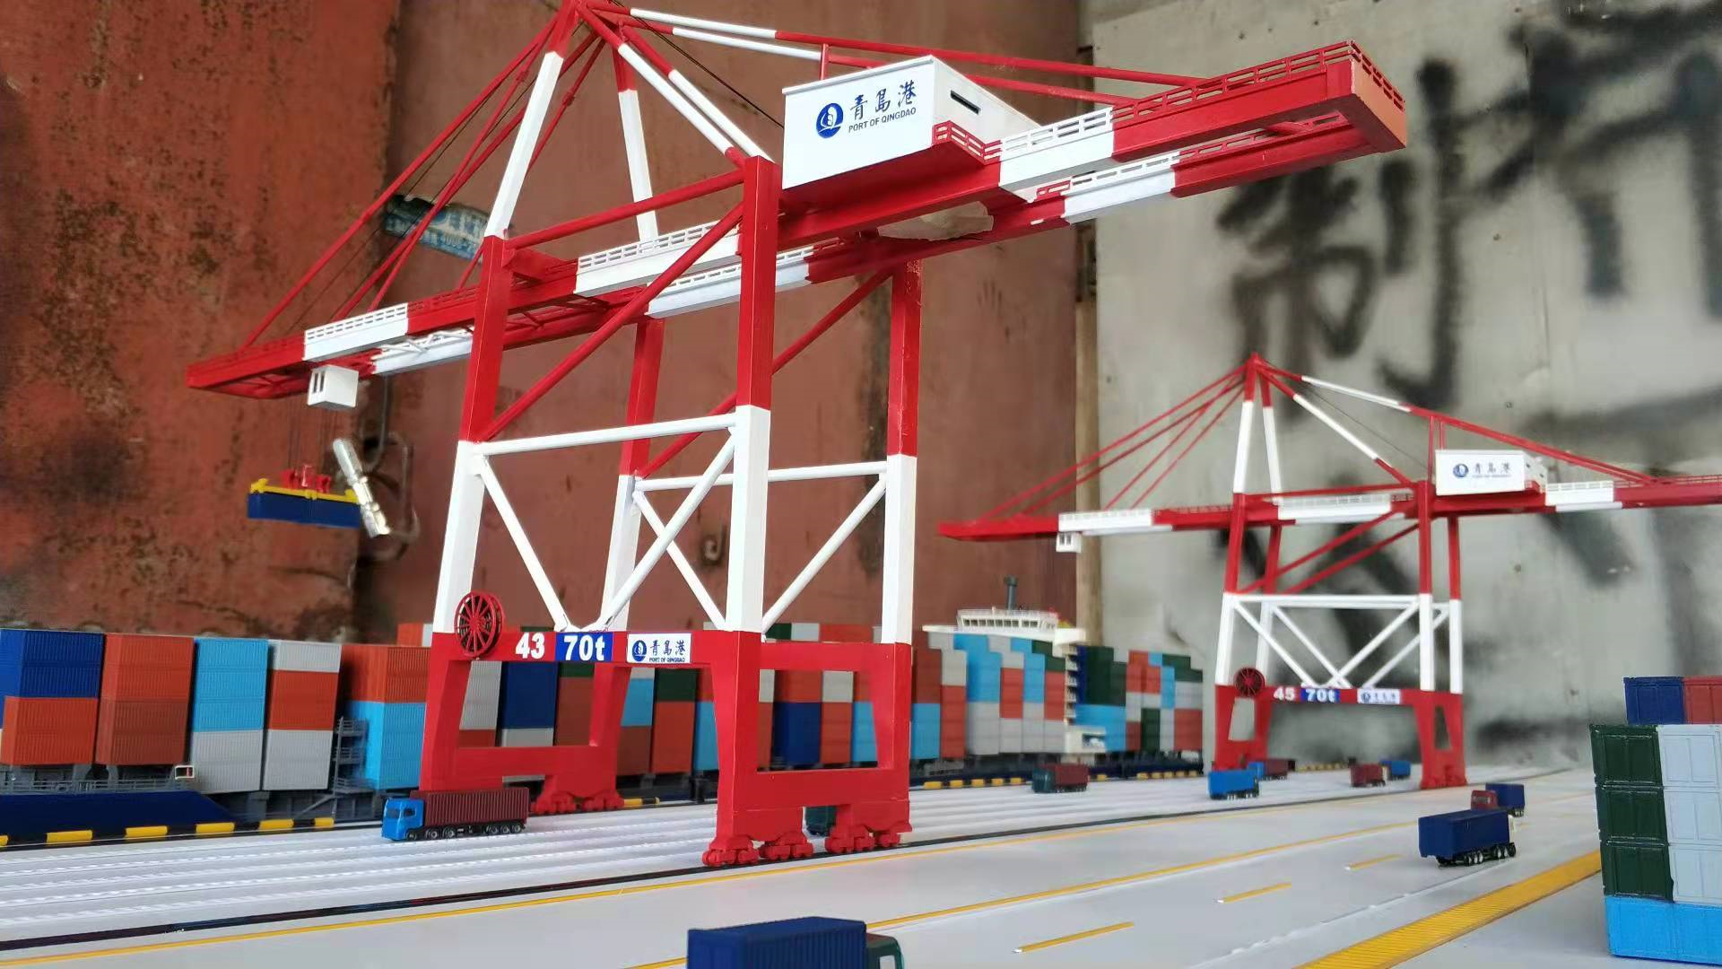
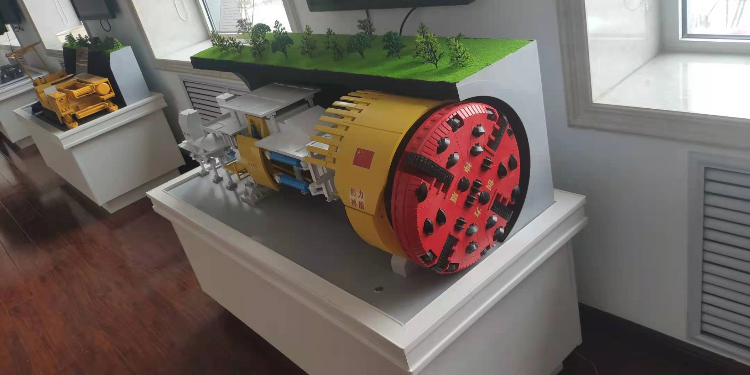
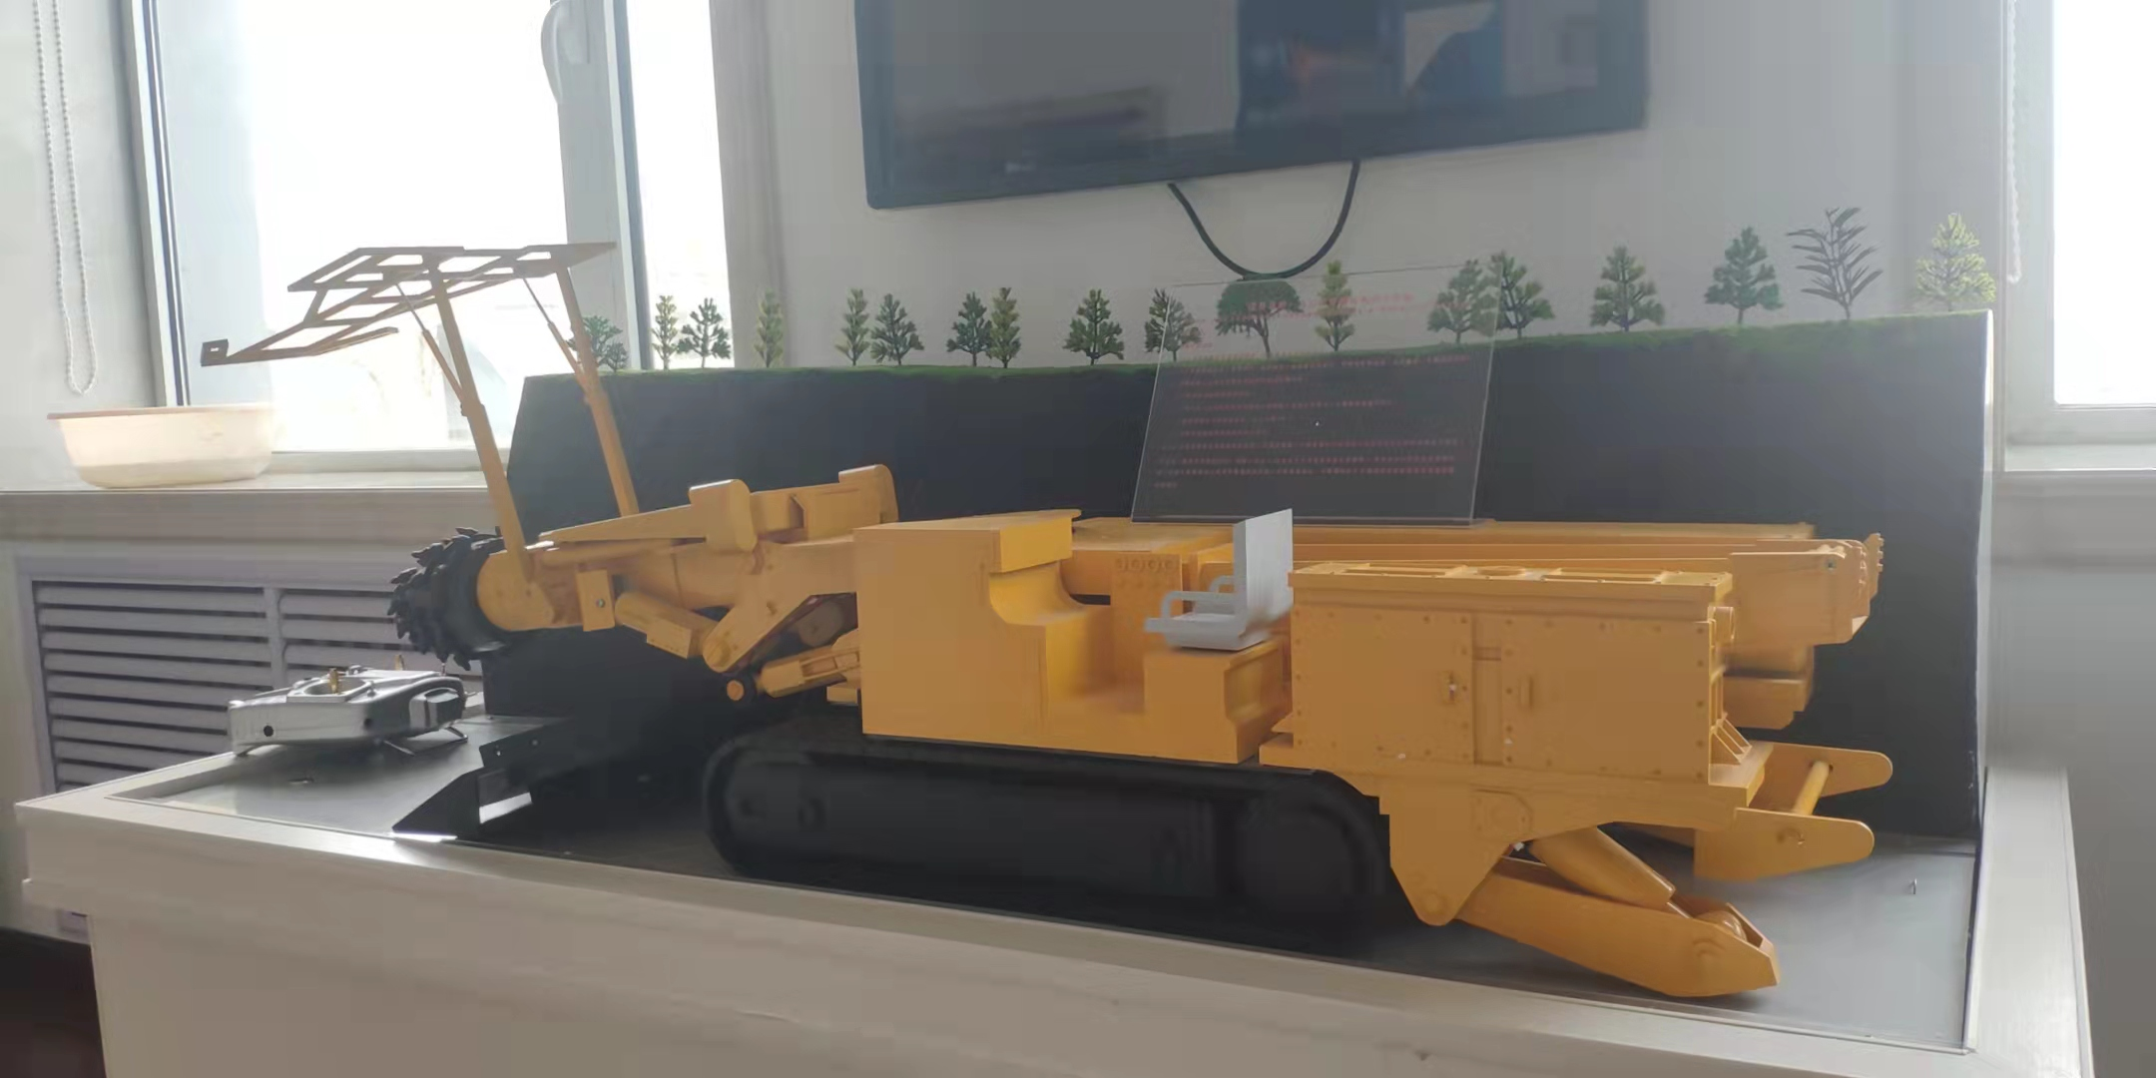
Mechanical Models

Slide 19
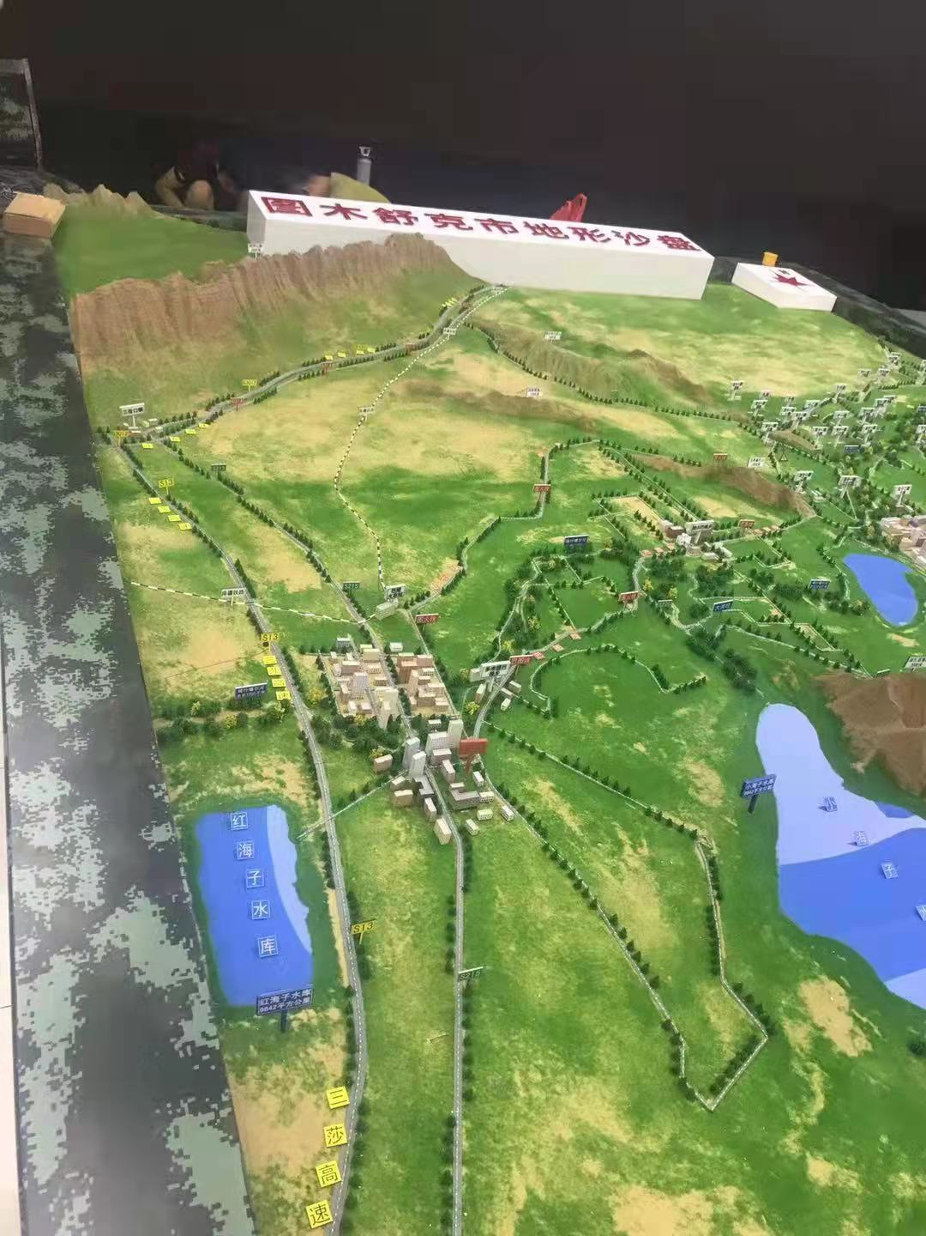
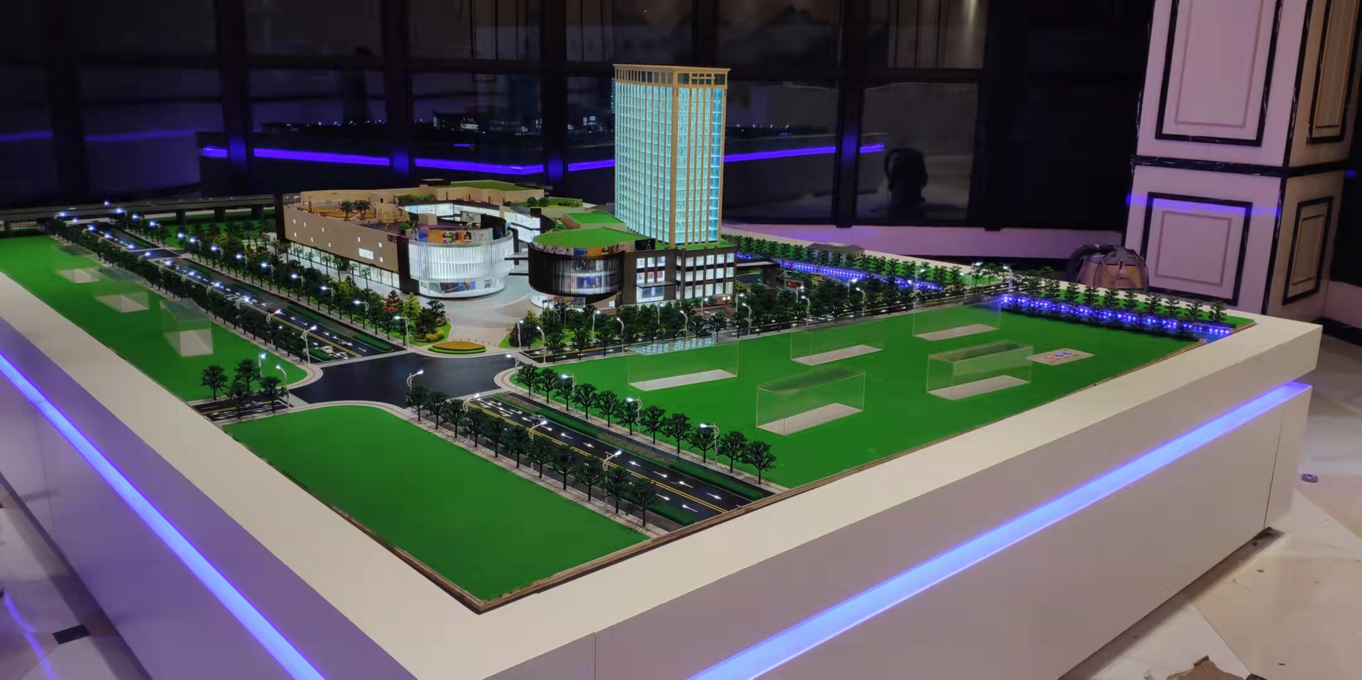
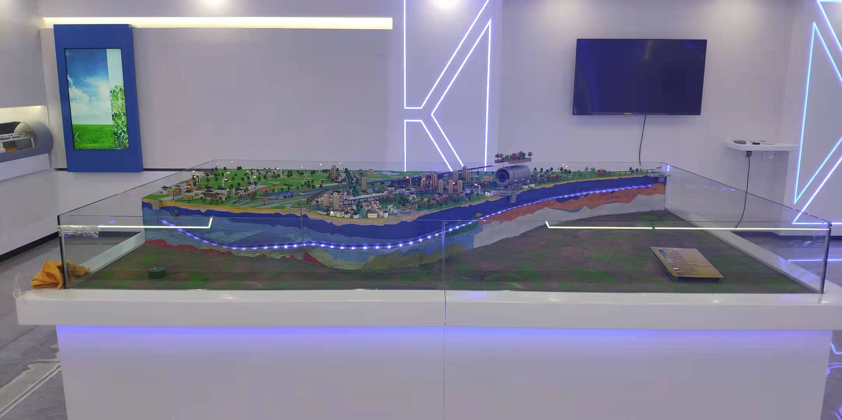
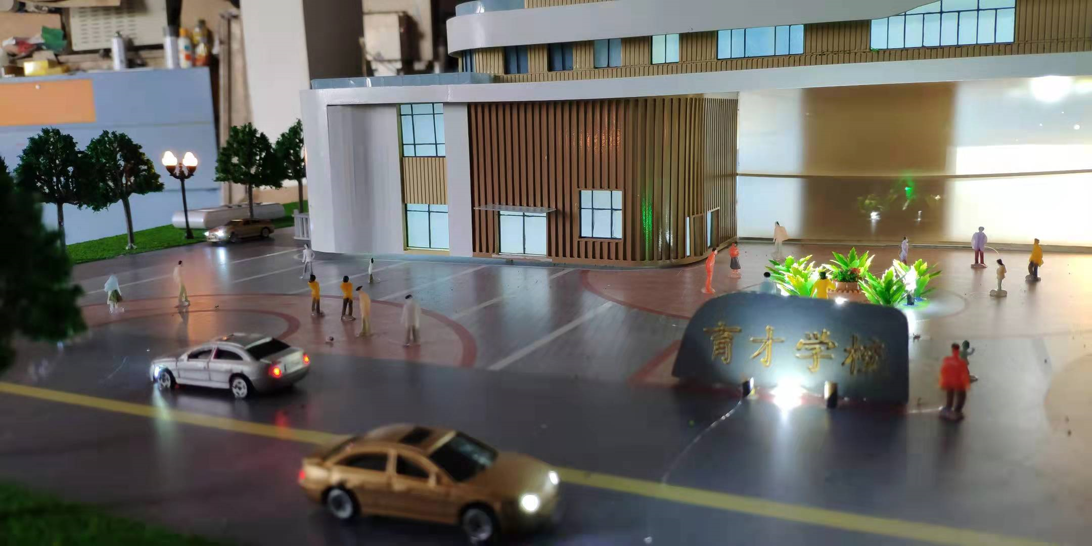
Sand Table Models

Slide 20
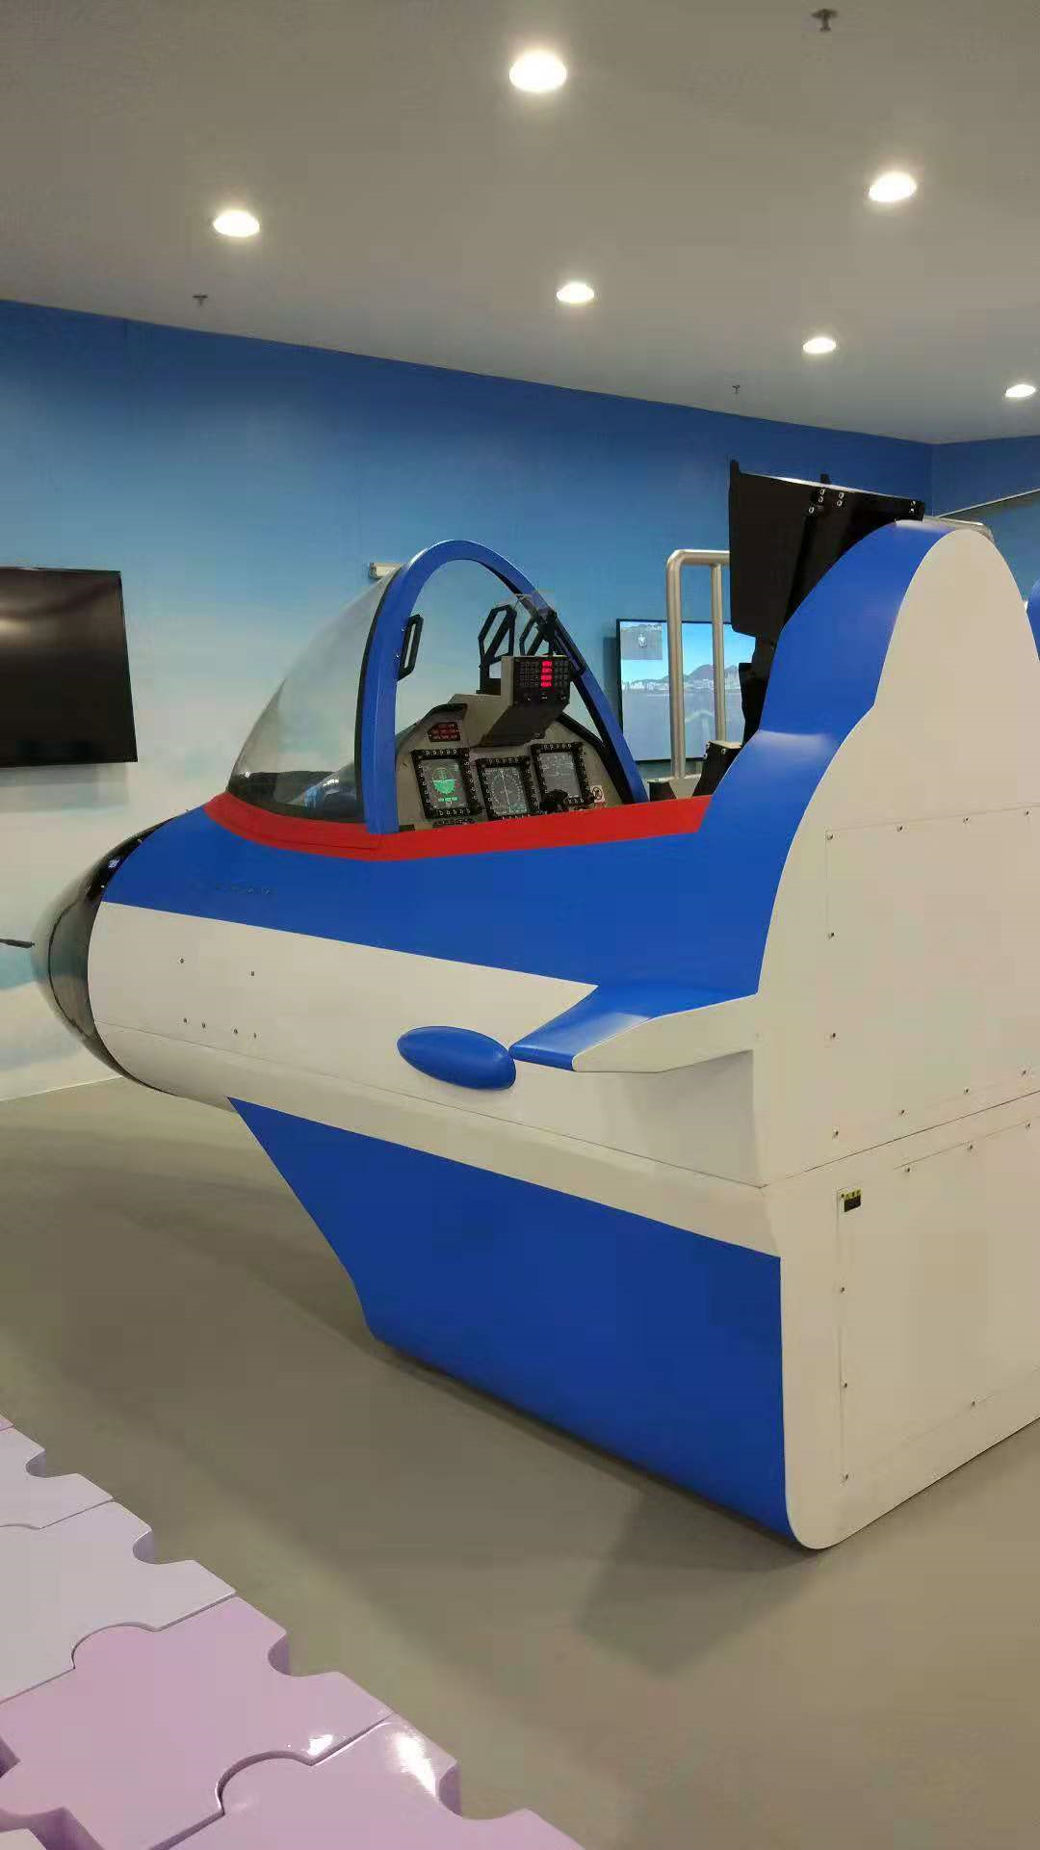
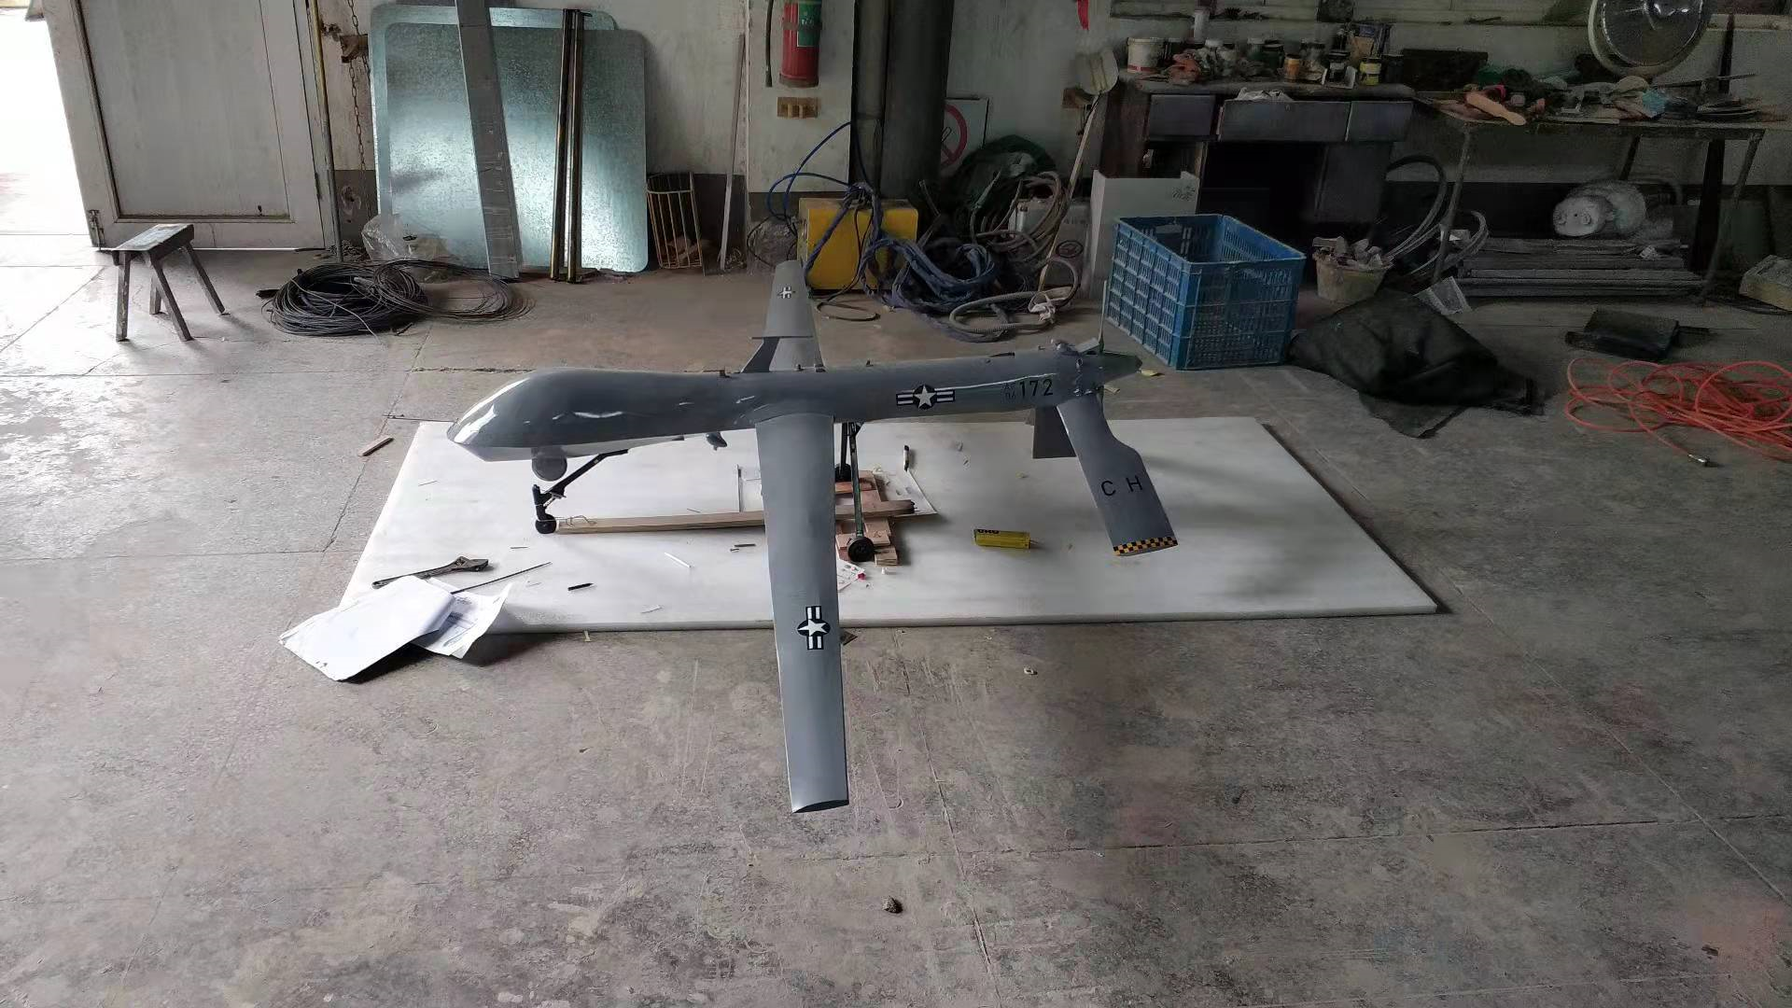
UAV Cockpit Model

Slide 21
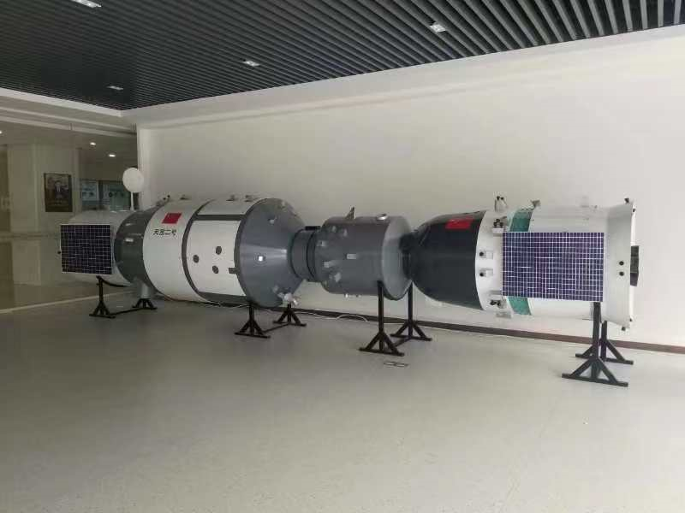
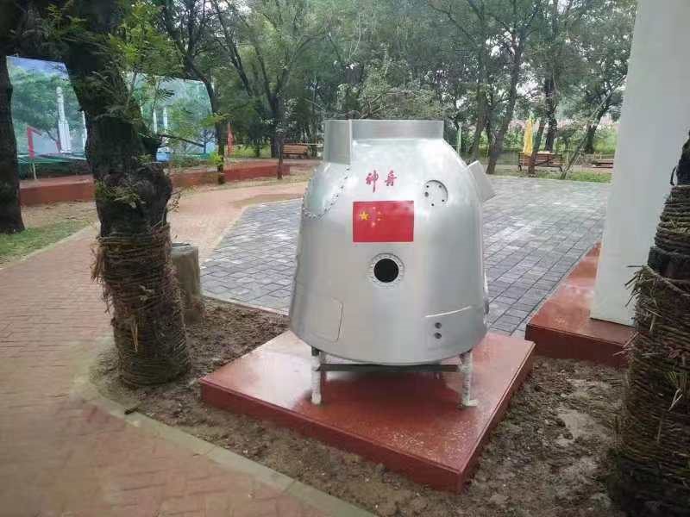
Capsule Model

Slide 22
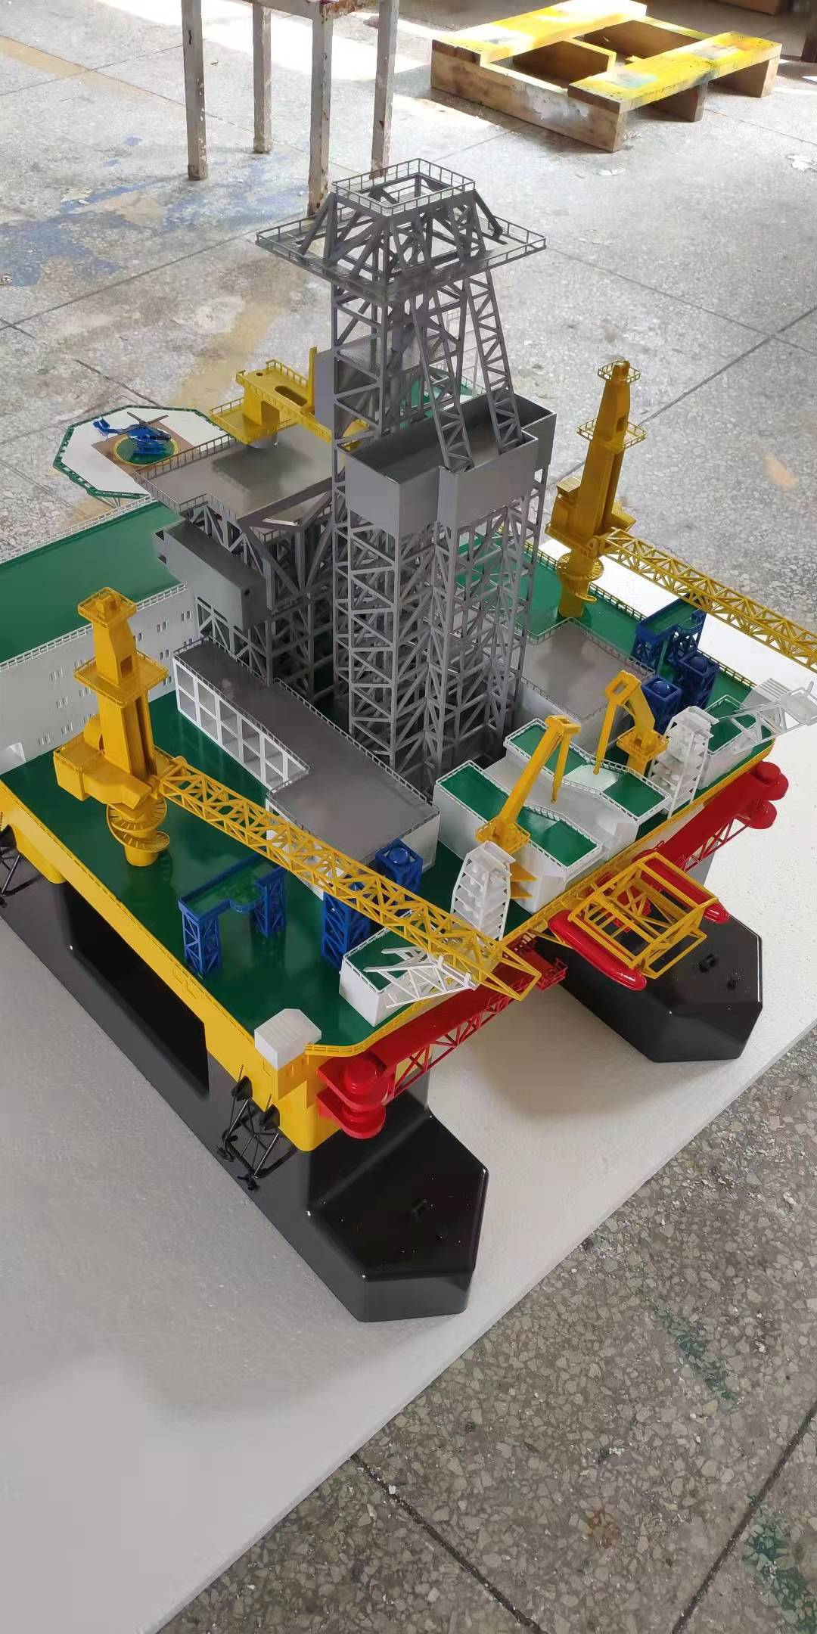
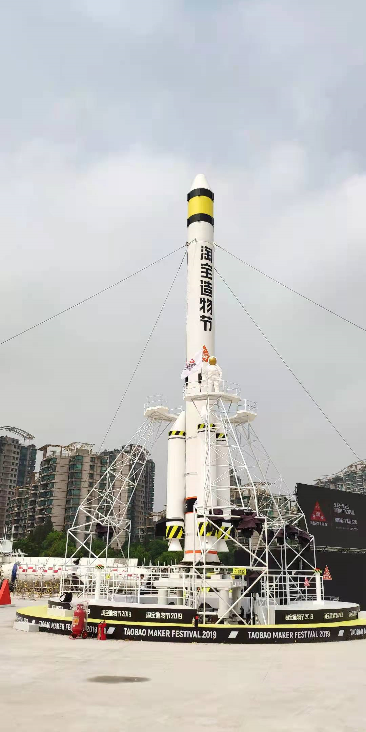
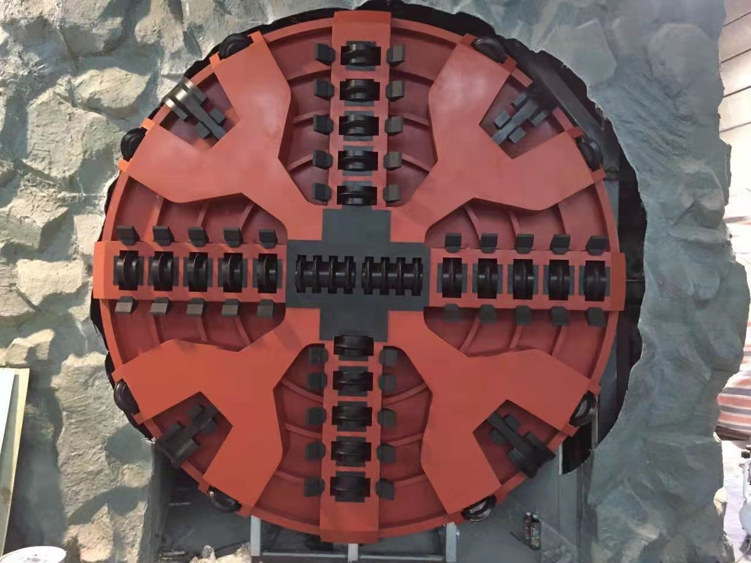
01
02
03

Slide 23
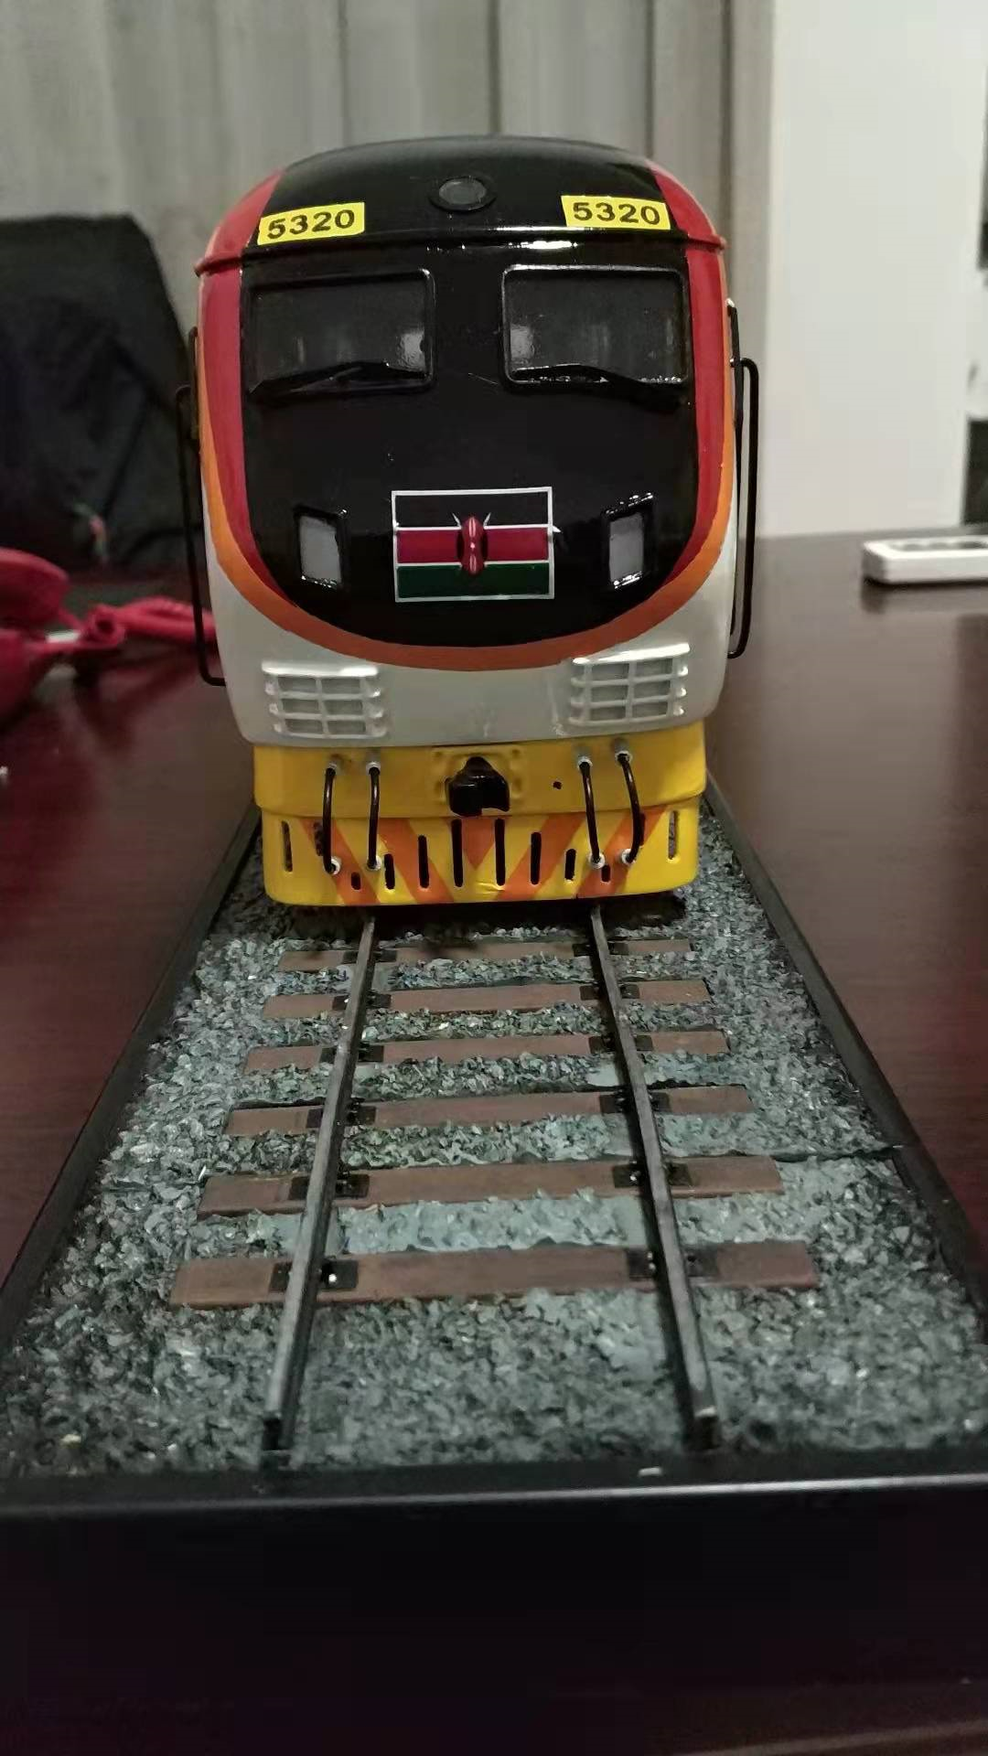
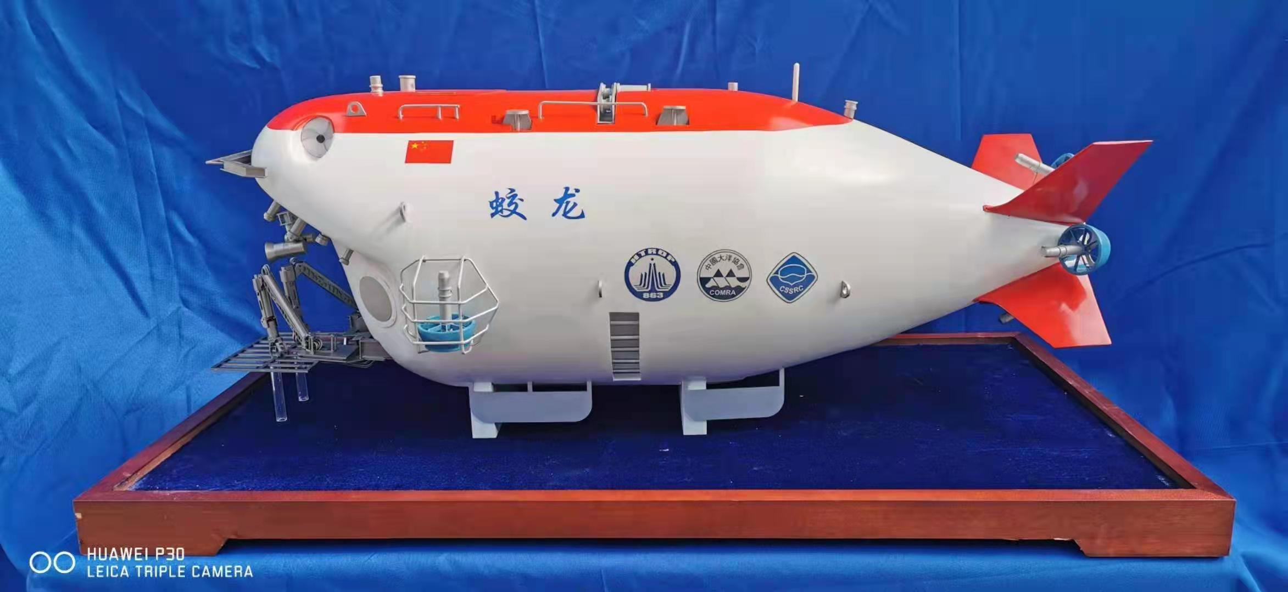

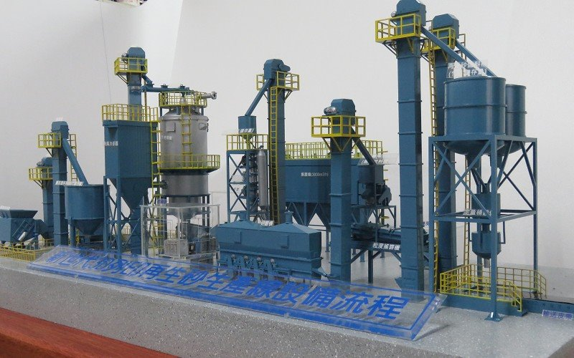
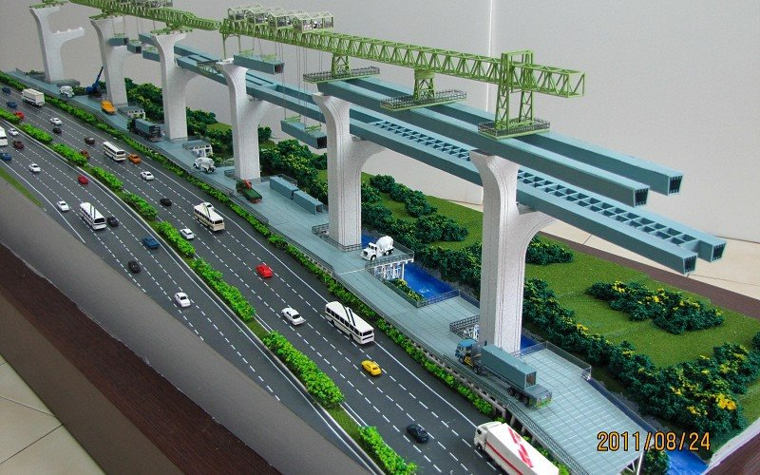
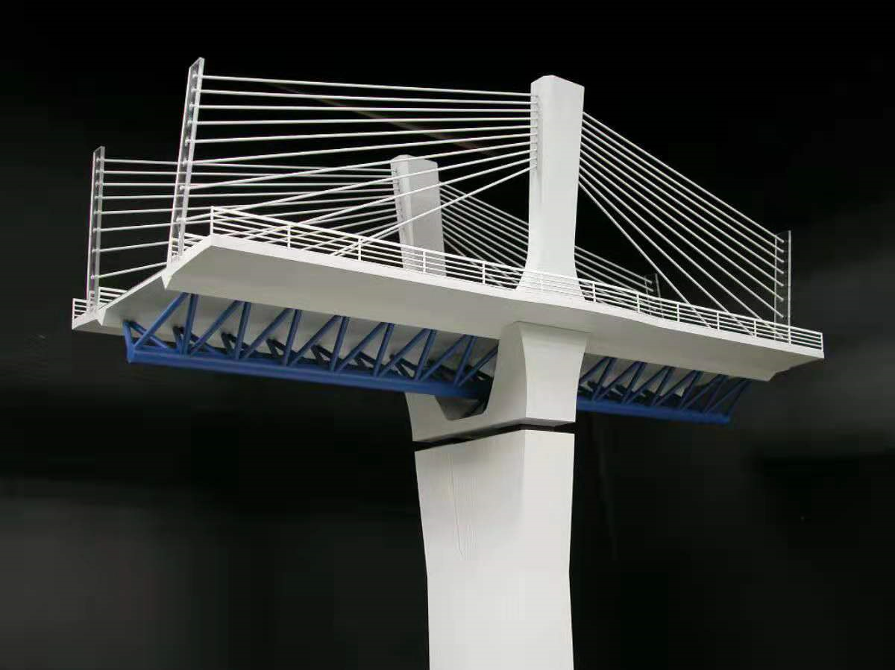
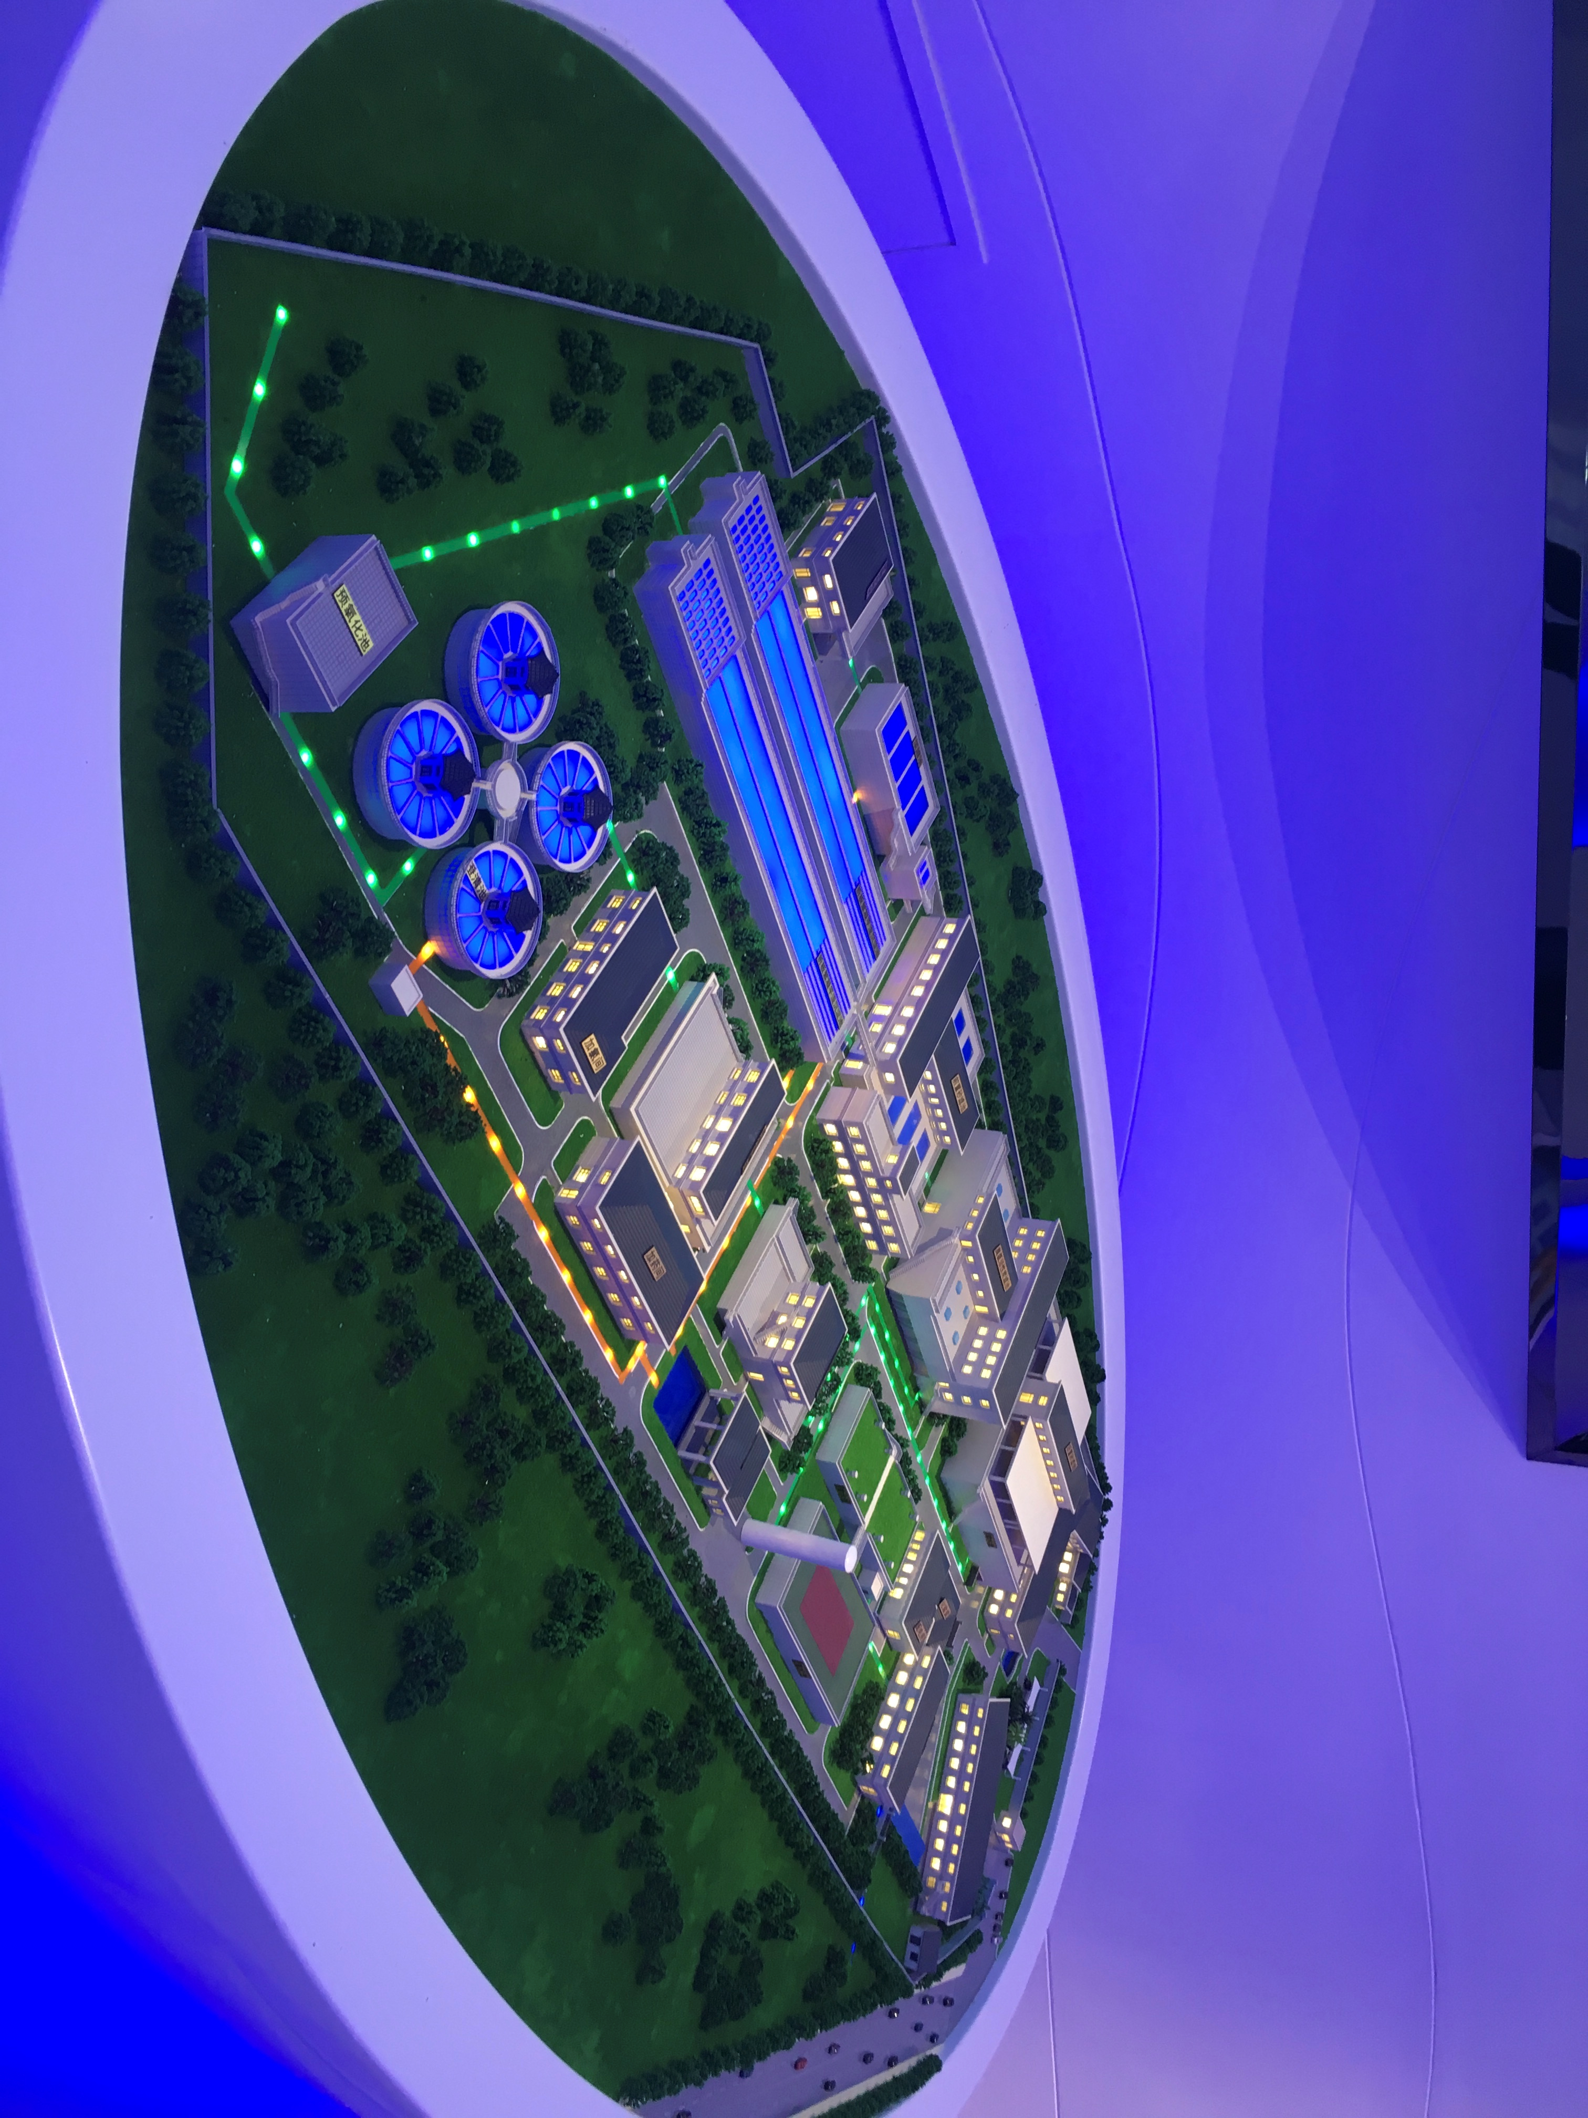
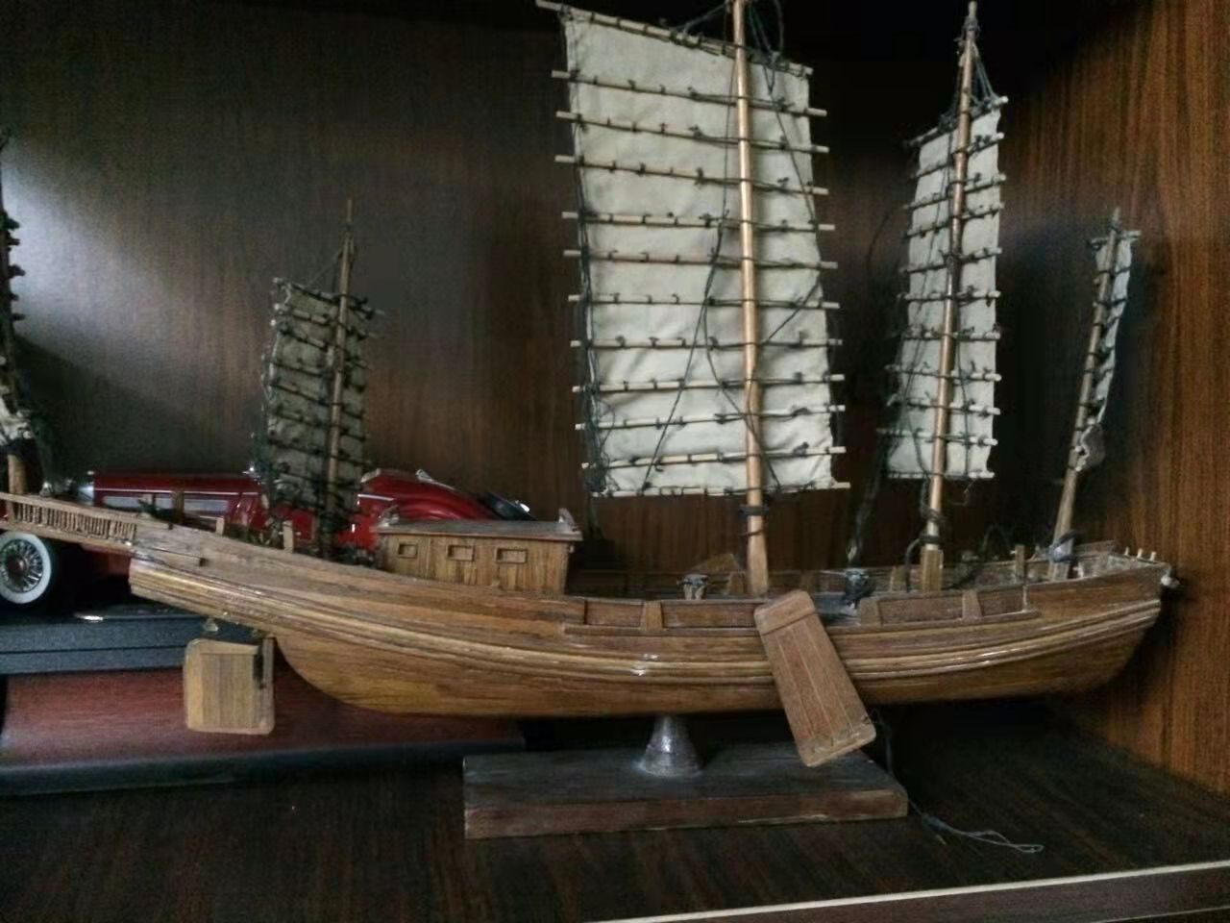
More Products

Slide 24
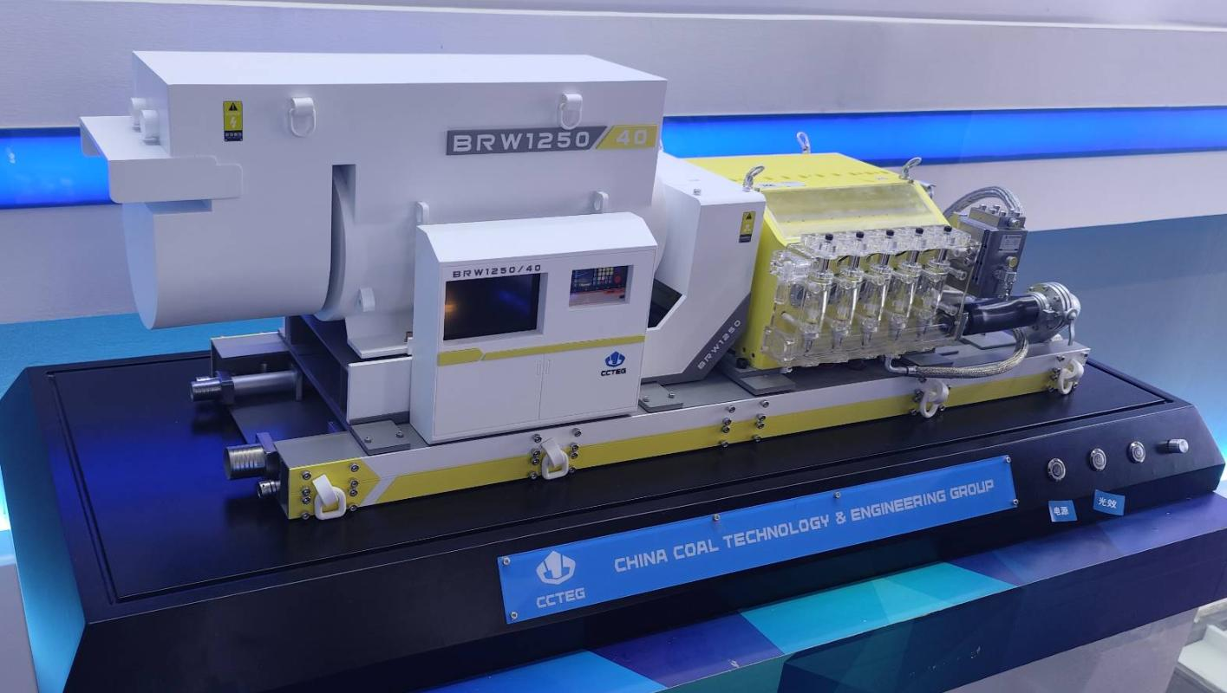
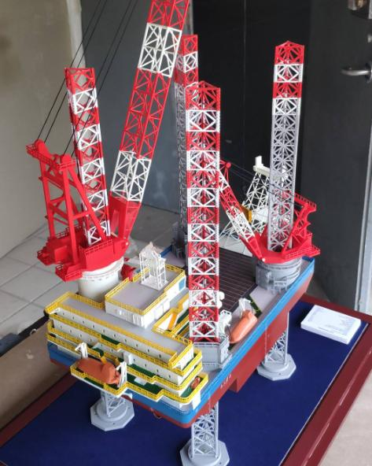
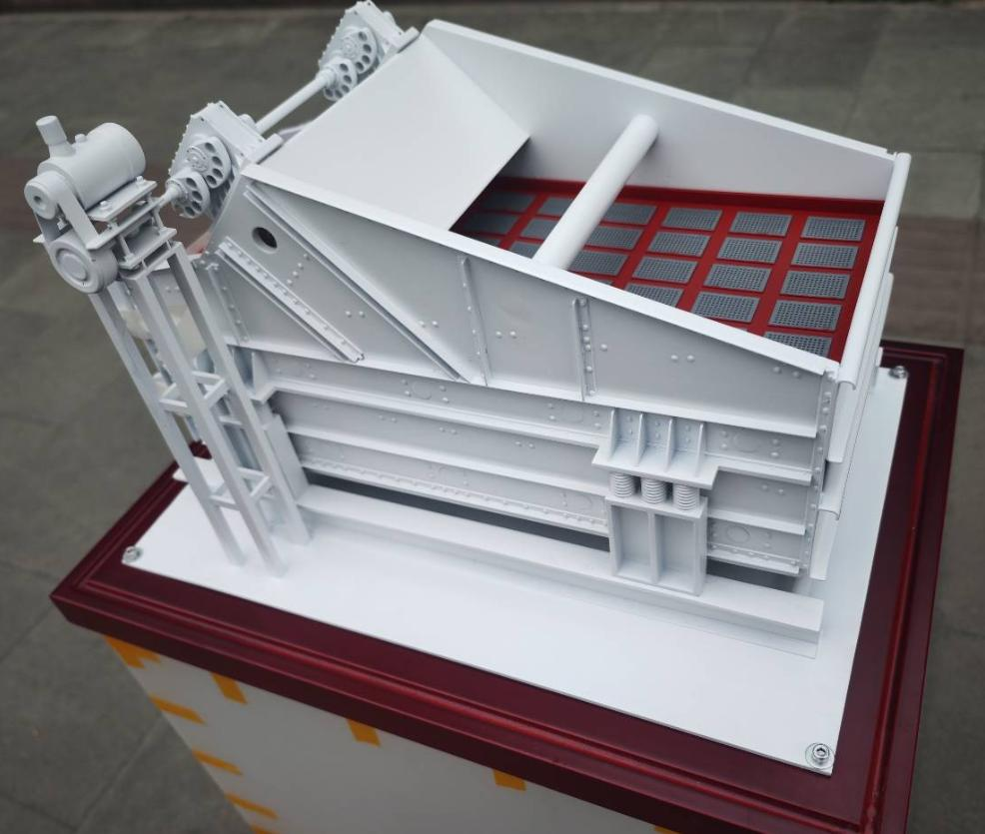
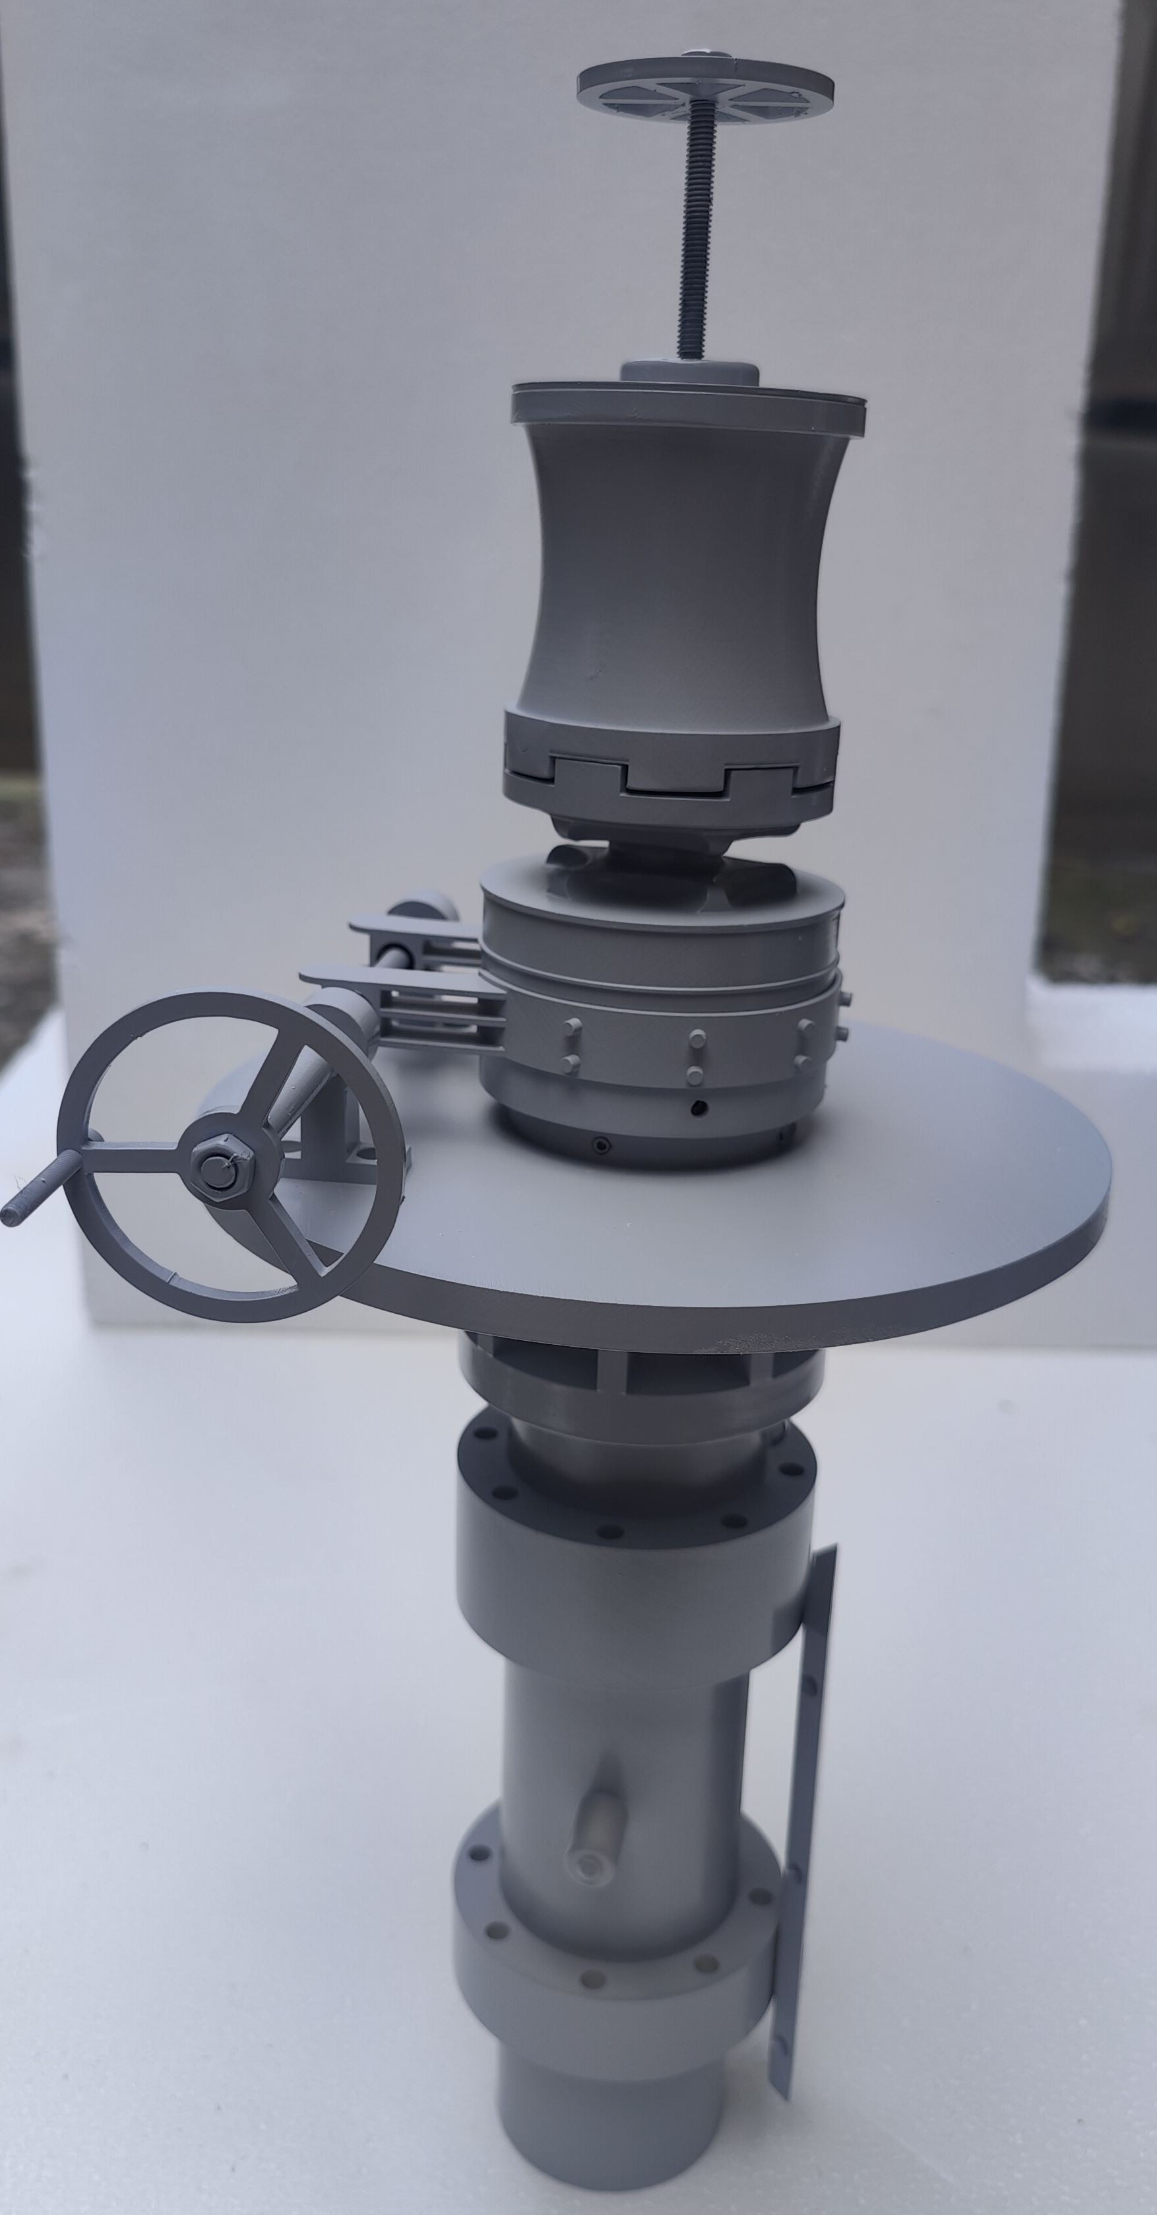
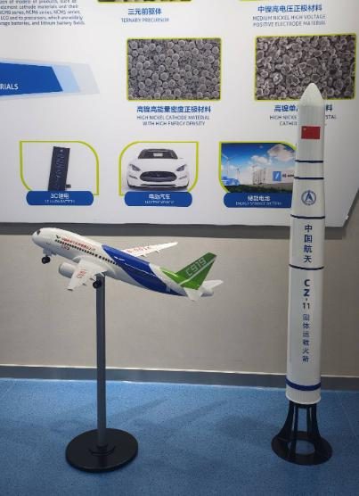
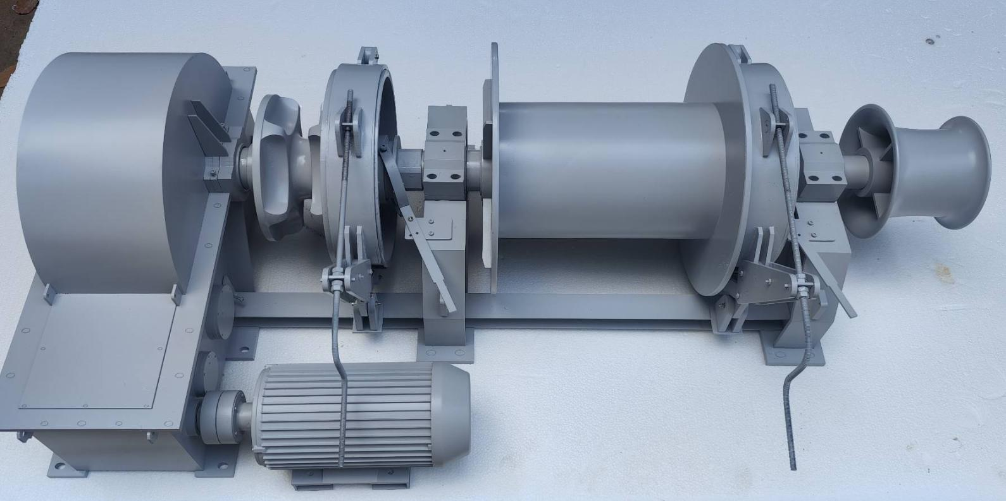

Slide 25
Cooperative partner

Slide 26
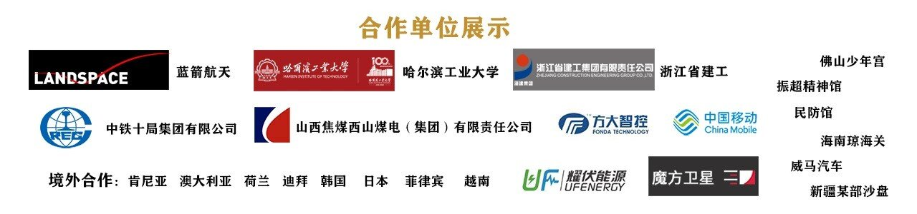
中煤北京煤矿机械有限责任公司
北京天玛智控科技股份有限公司
沈阳创新设计院有限公司
中南电力设计院
浙江至控科技有限公司
浙江华友钴业有限公司
宁夏石炭井炭化实业公司

Slide 27
Cooperative Partners
China Coal Beijing Coal Mining Machinery Co., Ltd., Beijing Tianma Intelligent Control Technology Co., Ltd., Shenyang Innovation Design Institute Co., Ltd., Central Southern China Electric Power Design Institute, Zhejiang Zhikong Technology Co., Ltd., Zhejiang Huayou Cobalt Co., Ltd., Ningxia Shitanjing Carbonization Industry Co., Ltd.

Slide 28


Company Address: Shimao Riverside Commercial Center, Hangzhou Economic and Technological Development Zone
Tel：+8615394281003
+86057187250650
Email：chinaqidian@126.com
www.hzqidian.com
www.qisnd.com

Slide 29
Thanks for watching

